Slide 1
Problem Faced By Urostomates In Nepal
Shanti Bajracharya
Enterostomal therapist

Slide 2
Urostomy- it is a simple and artificial opening in urinary tract on the body surface. Commonest urostomy is the ileal conduit. It is done for various reasons out of which the commonest ones are as follows
Carcinoma of bladder
Vesico vaginal fistula
Neurogenic bladder
Severe blaader and urethral injuries
Ectopic bladder

Slide 3
Current statistics of urostomates
Total Stoma patients who are under my care till date – around 4500
urostomates- 1800
Out of all the urostomates following were the indications for their urostomy.
Bladder carcinoma---1685
Neurogenic bladder----55
Ectopic bladder ---30
Traumatic VVF---25
congenital VVF----5

Slide 4
Ongoing care in Nepal
Stoma care started in Nepal since 1996. Since 18 years the service has been continuous, unoccluded and progressing with the help of different international and national support.
Currently stoma care is being run at two places in Kathmandu. One is at B&B hospital, Gwarko and other at NOA( Nepal Ostomy Association), kumaripati.

Slide 5
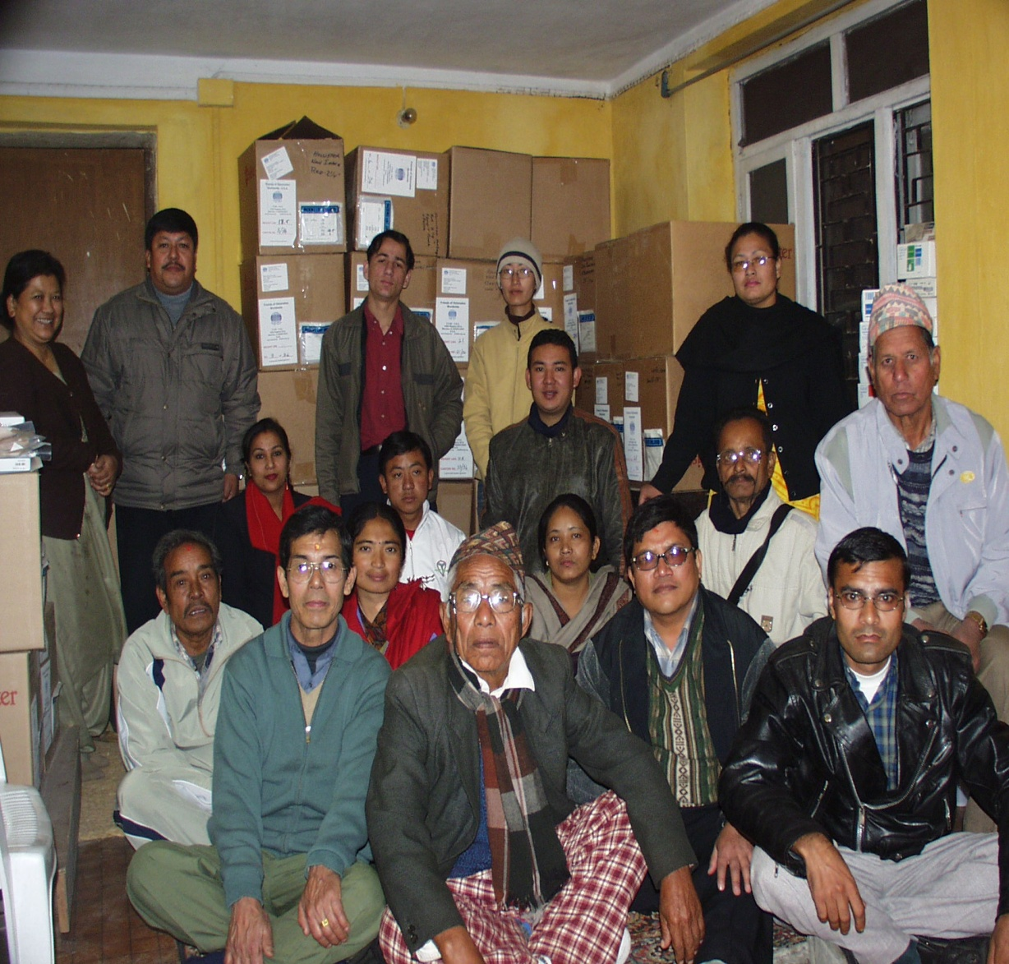
Nepal Ostomy Association

Slide 6
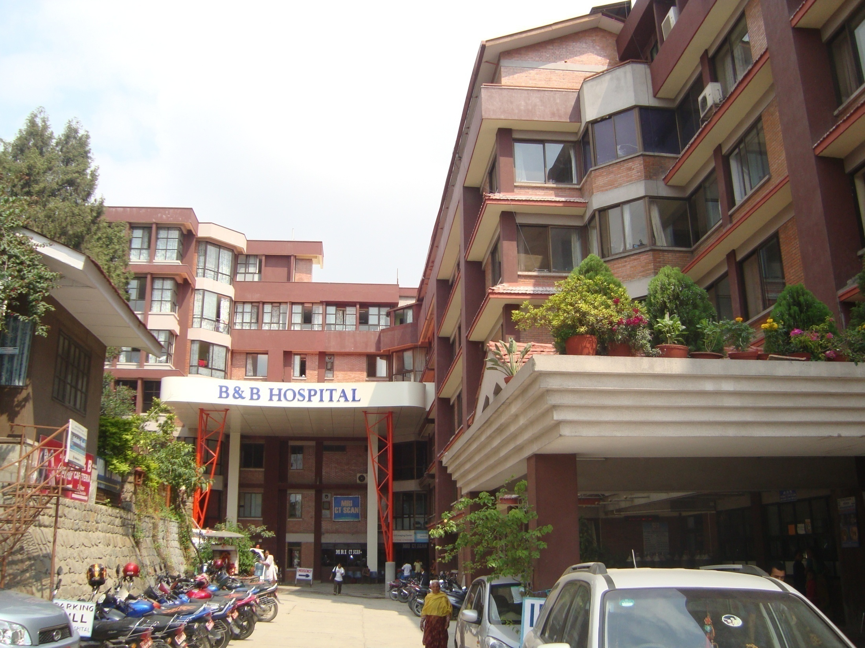

Slide 7
Few of the examples of urinary diversions and various problems faced by them.
Case one is of ectopic bladder (lack of information)
Case two is about congenital vesico vaginal fistula(poor economy)
Case three is about traumatic vesicovaginal fistula (poor health facility and lack of transportation)
Case four is about wrong stoma siting
Case five is social problem

Slide 8
Case 1: ectopic bladder undergone ileal conduit
Problem: lack of
information

Slide 9
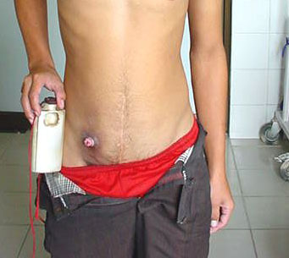

Slide 10
Case 2
Problem: psycho-social problem

Slide 11
Case 3: 18 yrs/F with congenital VVF undergone ileal conduit
Problem:
poor economy

Slide 13
Case 4: traumatic VVF undergone ileal conduit
Problem: inaccessibility

Slide 14
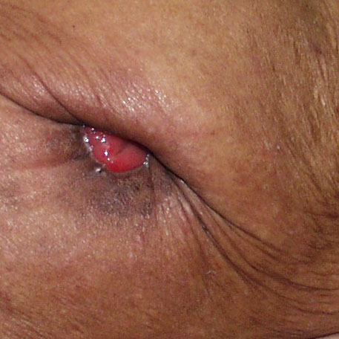
Difficulty in application of bag due to stoma siting
Bony prominence
Skin creases
Previous scars
Waist line
inaccessible to patient
Difficulty in
visibility to patient

Slide 15
Conclusion
As Urostomates live with their stoma and it will always remain as a part of their life, the comfort of their life depends upon their stoma siting, proper counseling and adequate information. Our care and support is really valuable for them.

Slide 16
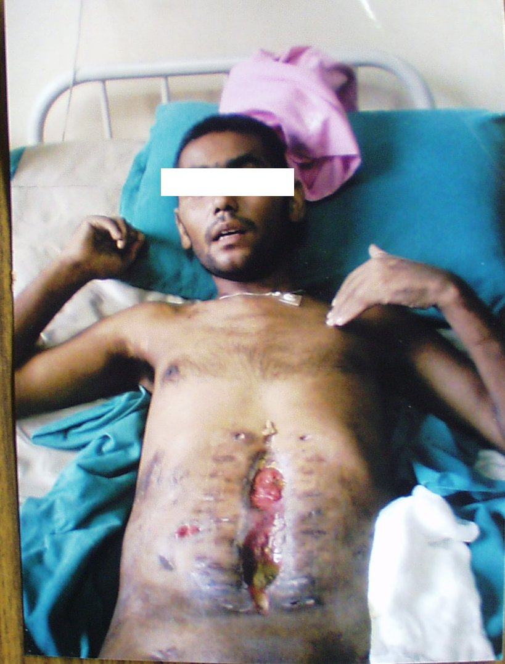
Complex colostomies

Slide 17
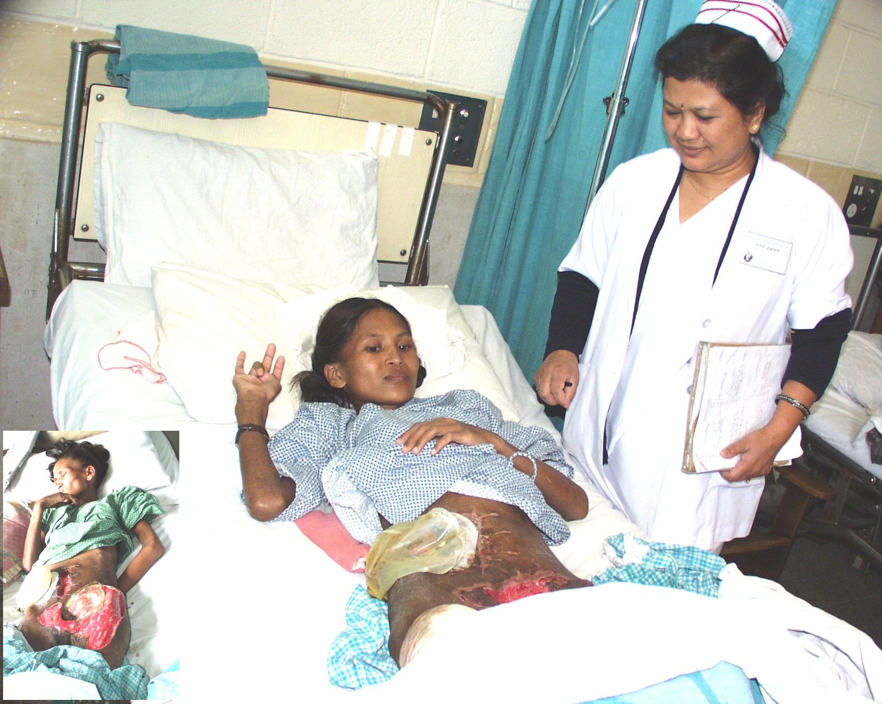

Slide 18
Thank you
Any question???

